Slide 2
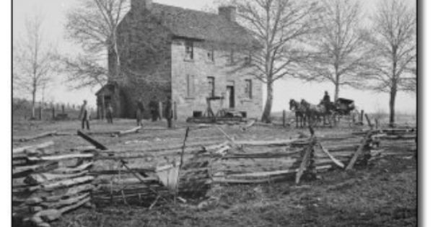
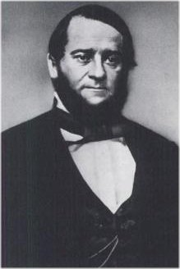
Wilmer McLean
Notes:
Wilmer McLean was 46 years old when the Civil War began in 1861. His farm was located at a spot called Manassas. A stream called Bull Run meandered through his property. Yes, you guessed it – the Civil War’s first major battle was the First Battle of Bull Run, or Manassas, because of where it was located.
His farmhouse was taken over as a Confederate headquarters, and day after McLean left with his family an artillery shell tore through his detached kitchen where the dinner of the Confederate general was being prepared. Three days later, the First Battle of Bull Run began. His barn was used as military hospital and jail.

Slide 3
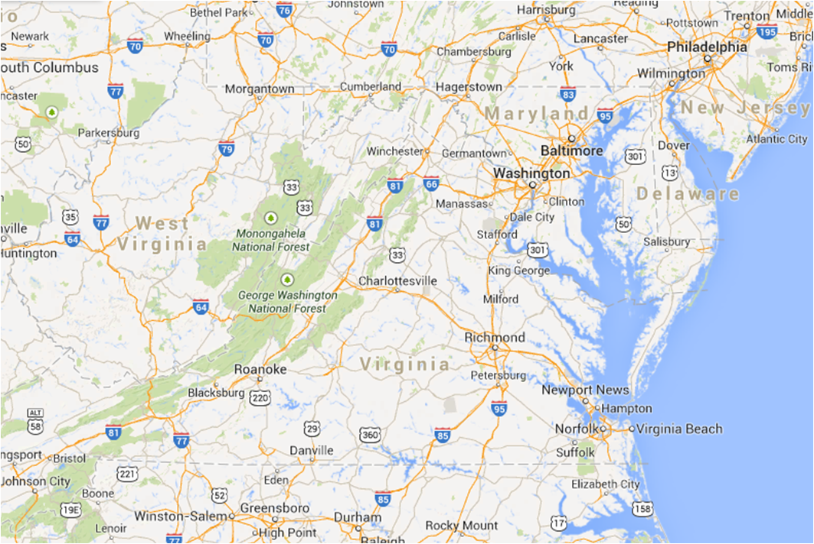
Appomattox Court House
Wilmer McLean
Notes:
Needless to say, McLean moved to more pleasant surroundings and in 1863 moved to a quiet place called Appomattox Court House on the other side of Virginia. That’s right, Appomattox Court House is where General Lee surrendered to General Grant.

Slide 4
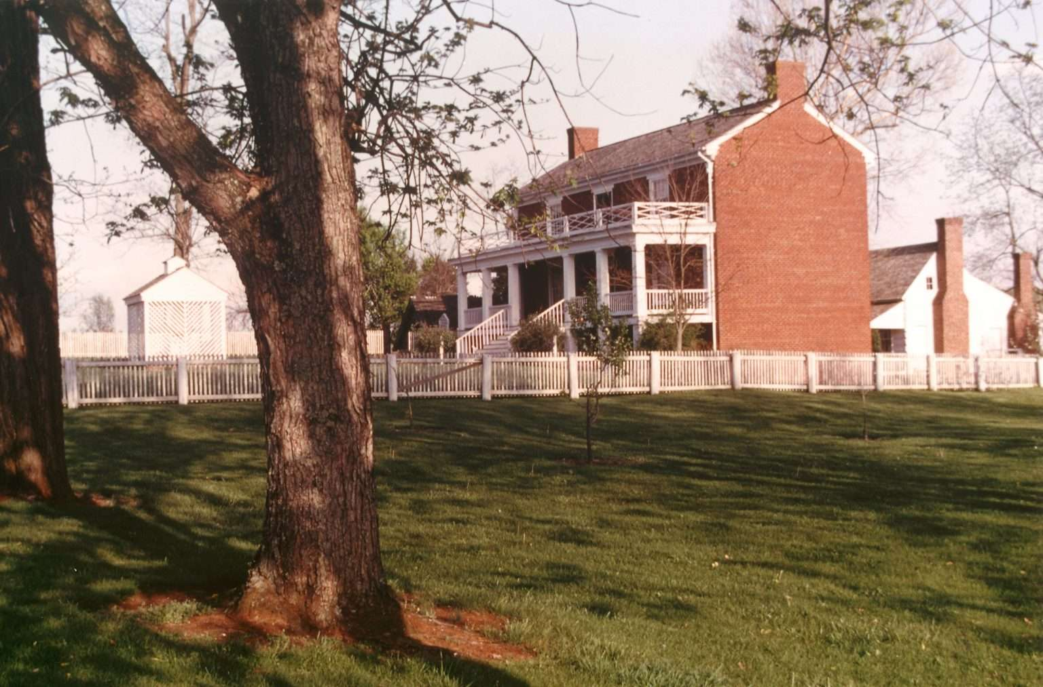
“The war began in my front yard and ended in my front parlor.”
Wilmer McLean
Notes:
After Lee departed his house was ransacked by Union officers. As McLean protested, the soldiers walked out with the tables and chairs used by Lee and Grant, a stone inkstand, brass candlesticks and even the favorite rag doll of his 7-year-old daughter, Lula. They tore apart McLean’s cane-bottomed chairs and cut upholstery strips from his sofas as mementoes. As compensation, the soldiers shoved money into the hands of the unwilling seller and threw it onto the floor when he refused to accept it.
McLean told a Confederate general the next day, “These armies tore my place on Bull Run all to pieces, and kept running over it backward and forward till no man could live there,” “And now, just look around you! Not a fence-rail is left on the place, the last guns trampled down all my crops, and Lee surrenders to Grant in my house.”

Slide 5

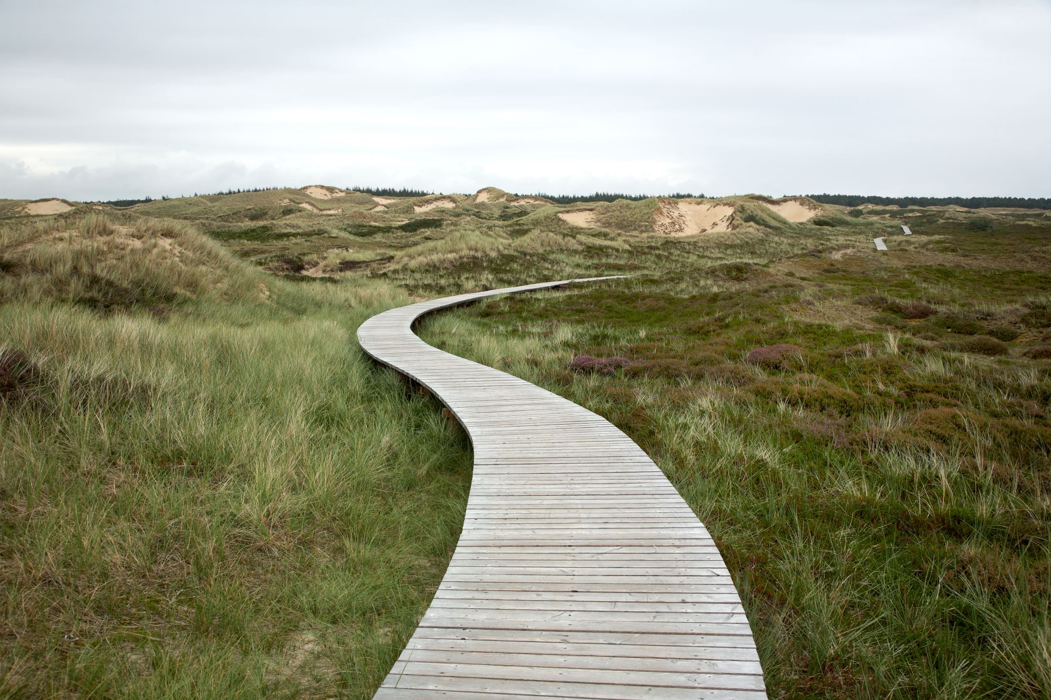
Where Could I Go?
Seeking a better place
Notes:
Do you ever desire to find greener pastures – to a better place?
From the illustration of Wilmer McLean, it may seem like we should be content where we are since we come to realize that greener pastures aren’t really greener after all.
However, was Mr. McLean’s move a reasonable one?
Yes. The point is not that we should never desire someplace better, but rather, we should have realistic goals of that better place.
As we know and as I will point out, in this life, nothing is certain. This world will continute to disappoint.
We only have certainty in what God has prepared for us and that is the place we should desire.

Slide 6
Seeking a better place is rational
Elijah (1 Kings 19)
Flee to next city (Matthew 10:23)
Jesus’s family (Matthew 2)
Jerusalem church (Acts 8)
Disciples at the destruction of Jerusalem (Matthew 24:15-16f)
Jews in Nazi Germany
Afghanistan (2021)
Notes:
Yes, we are to be content (1 Timothy 6:8), but that does not mean that we shouldn’t take advantage of moving someplace better.
Were you called while a slave? Do not worry about it; but if you are able also to become free, rather do that. (1 Corinthians 7:21)
Elijah fleeing Jezebel
"But whenever they persecute you in one city, flee to the next; for truly I say to you, you will not finish going through the cities of Israel until the Son of Man comes.(Matthew 10:23)
Saul was in hearty agreement with putting him to death. And on that day a great persecution began against the church in Jerusalem, and they were all scattered throughout the regions of Judea and Samaria, except the apostles.(Acts 8:1)
"Therefore when you see the ABOMINATION OF DESOLATION which was spoken of through Daniel the prophet, standing in the holy place (let the reader understand), then those who are in Judea must flee to the mountains.(Matthew 24:15-16)
Refugees are fleeing Afghanistan.
Parents giving up children, and people clinging onto planes as they left – image of person falling from plane – person found dead in wheel well of plane after landing. These extreme efforts to escape Afghanistan indicate at least a perceived expectation of worsening conditions in that country.
They are looking for a better place.

Slide 7
Close to family
Good schools
Healthcare / medical facilities
Healthy environment
Safety / Low crime
Pleasant and safe climate
Employment opportunities; Salary
Low cost of living
Fair government / low taxes
Recreation / social opportunities
Freedom and rights
Culture / morality
Freedom from persecution
Notes:
What do you look for when selecting your “pasture?”
Have to weight the costs and benefits everywhere.
For me, in the US, I see deterioration of moral values and an increase in assaults against what is good.
Don’t know exact future of US, but we need to move away from the idea that since all is well now, all will continue to be well in the future.

Slide 8

Where Can I Go?
Notes:
There are pockets of safety, such as Arkansas and Texas, but as the federal government extends its power, we are exposed to losing those safe areas. So, I ask, where could I go?

Slide 9
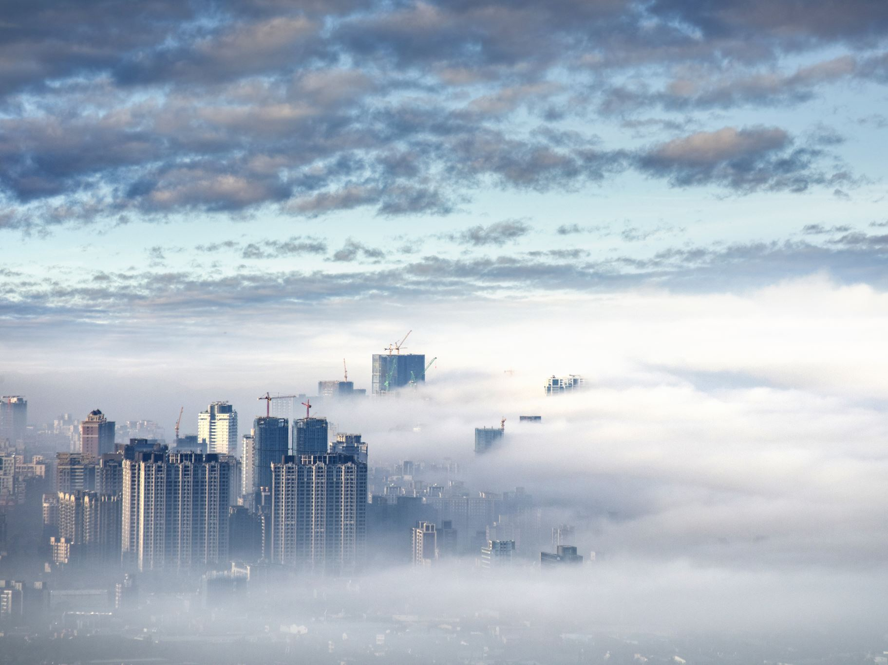
Come now, you who say, "Today or tomorrow we will go to such and such a city, and spend a year there and engage in business and make a profit." Yet you do not know what your life will be like tomorrow. You are just a vapor that appears for a little while and then vanishes away.
James 4:13-14
Notes:
Problem: Nothing is certain
No matter where we go, we find ourselves in the same or similar situation

Slide 10
Man, who is born of woman, Is short-lived and full of turmoil.
Job 14:1
What man can live and not see death? Can he deliver his soul from the power of Sheol?
Psalm 89:48
Notes:
In this life, relocating is a temporary fix.
Religious persecution, progressive immorality and wickedness, crime, disease, accidents, natural disasters, government oppression, and death.
Dangers are still there. We will never escape the possibility of disease, suffering, accidents, and most certainly, death.
Don’t be fooled into thinking are immune to these things. Moving may postpone some dangers and will not alleviate all dangers. In the end, in this life we have no hope. We need to be looking for a better place and that place is not in this world. Move away from seeking another place in this world and in this life.

Slide 11
Where Can I Go?
Notes:
So again, I ask, “Where can I go?”

Slide 12

Do not store up for yourselves treasures on earth, where moth and rust destroy, and where thieves break in and steal.
But store up for yourselves treasures in heaven, where neither moth nor rust destroys, and where thieves do not break in or steal.
Matthew 6:19-20

Slide 13
For we know that if the earthly tent which is our house is torn down, we have a building from God, a house not made with hands, eternal in the heavens.
2 Corinthians 5:1
Notes:
McLean’s home became unusable, so he sought for another.

Slide 14
Blessed be the God and Father of our Lord Jesus Christ, who according to His great mercy has caused us to be born again to a living hope through the resurrection of Jesus Christ from the dead, to obtain an inheritance which is imperishable and undefiled and will not fade away, reserved in heaven for you,
1 Peter 1:3-4

Slide 15
we who have taken refuge would have strong encouragement to take hold of the hope set before us. This hope we have as an anchor of the soul, a hope both sure and steadfast …,
Hebrews 6:18-19

Slide 16

Hebrews 11:8-16
Notes:
Hebrews 11:8-16
for he was looking for the city which has foundations, whose architect and builder is God.
they are seeking a country of their own.
they desire a better country, that is, a heavenly one.
Unlike Israel who always looked back to Egypt.
We have an escape that God has prepared for us.
But notice “if they had been thinking of that country from which they went out…” That’s why I want to stress the negatives of living in the world.
Alan, aren’t you optimistic? Why so negative. Because no matter what politician is elected, no matter what president, no matter what supreme court decision, this world is passing away.
Many are happy by ignoring reality. That is their escape. They retreat to their happy place. We can ignore these for only so long.
If we don’t realize the negatives in this world, we don’t see the need to desire a better country.

Slide 17
… and if He rescued righteous Lot, oppressed by the sensual conduct of unprincipled men (for by what he saw and heard that righteous man, while living among them, felt his righteous soul tormented day after day by their lawless deeds), …
2 Peter 2:7-8
Notes:
Consider why Lot’s soul was tormented. It is not that others tormented him, but rather that he was tormented by what he saw.
Are we not tormented when we see the wickedness, immorality, depravity around us?

Slide 18
All these died in faith, without receiving the promises, but having seen them and having welcomed them from a distance, and having confessed that they were strangers and exiles on the earth. (Hebrews 11:13)
In all this, they are surprised that you do not run with them into the same excesses of dissipation, and they malign you (1 Peter 4:4)
Do not be surprised, brethren, if the world hates you. (1 John 3:13)
Beloved, do not be surprised at the fiery ordeal among you, which comes upon you for your testing, as though some strange thing were happening to you (1 Peter 4:12)
Notes:
We should feel out of place.
We should not feel comfortable in this world.
We are a peculiar people.
Consider why Lot’s soul was tormented.
Are we not tormented when we see the wickedness, immorality, depravity around us?
Strangers and exiles – this world was not their home – they felt out of place
The world cannot understand us – they make fun of us
The world hates us – there is no such thing as coexistence – IF you truly stand for what is right
The world will persecute us

Slide 19
When morning dawned, the angels urged Lot, saying, "Up, take your wife and your two daughters who are here, or you will be swept away in the punishment of the city." But he hesitated. So the men seized his hand and the hand of his wife and the hands of his two daughters, for the compassion of the LORD was upon him; and they brought him out, and put him outside the city.
Genesis 19:15-16
Notes:
Even righteous Lot did not see it.
Lot had first set his tents outside Sodom, then in Sodom, then he sat in the city gate
He hesitated
He stayed in Sodom too long – his wife, his daughters

Slide 20
A good name is better than a good ointment, And the day of one's death is better than the day of one's birth. It is better to go to a house of mourning Than to go to a house of feasting, Because that is the end of every man, And the living takes it to heart.
Ecclesiastes 7:1-2
Notes:
If they had been thinking of the city from which they came…..
Death puts us in the right perspective to help us assess
Those without hope live in despair – many suicides from pandemic and lockdown.
They are not able to see what is better.

Slide 21
For we must all appear before the judgment seat of Christ, so that each one may be recompensed for his deeds in the body, according to what he has done, whether good or bad.(2 Corinthians 5:10)

Slide 22
But the day of the Lord will come like a thief, in which the heavens will pass away with a roar and the elements will be destroyed with intense heat, and the earth and its works will be burned up. Since all these things are to be destroyed in this way, what sort of people ought you to be in holy conduct and godliness, looking for and hastening the coming of the day of God, …
(2 Peter 3:10-12)

Slide 23
And I heard a voice from heaven, saying, "Write, 'Blessed are the dead who die in the Lord from now on!'" "Yes," says the Spirit, "so that they may rest from their labors, for their deeds follow with them.“ (Revelation 14:13)
it is appointed for men to die once and after this comes judgment (Hebrews 9:27)
"Then the King will say to those on His right, 'Come, you who are blessed of My Father, inherit the kingdom prepared for you from the foundation of the world. (Matthew 25:34)

Slide 24
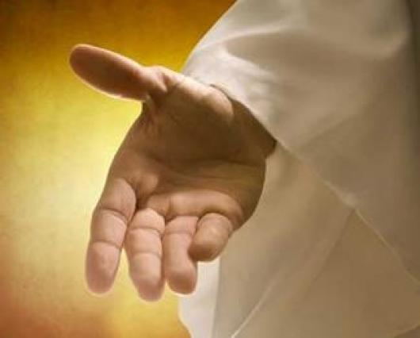
In the world you have tribulation, but take courage; I have overcome the world."
John 16:33

