Slide 1
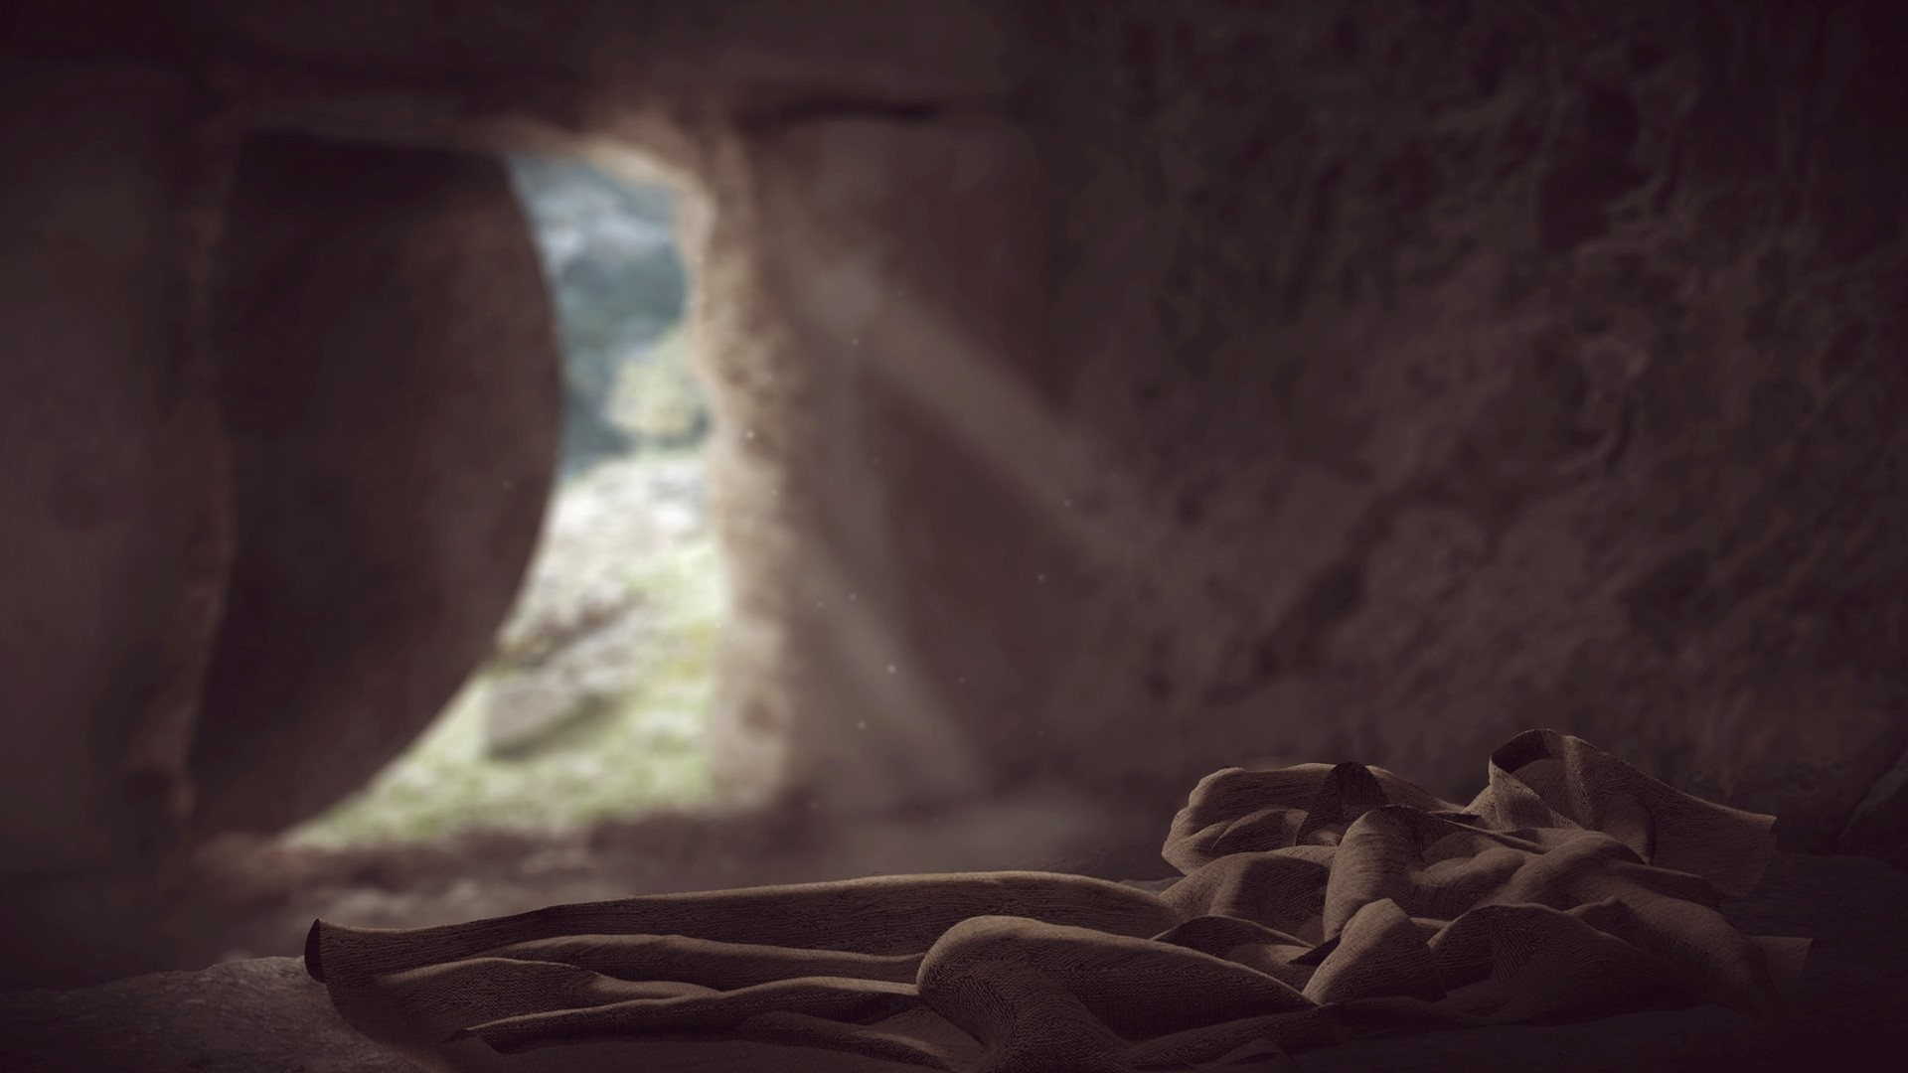
The Gospel Message

Slide 2

Summary
Romans 1:16-21
1 Corinthians 15:1-5
John 3:16
John 8:23-24, 58 (2 John 1:7)
Romans 10:8-10
Romans 6:1-13

Slide 3
SUMMARY
God created the universe and provides evidence of such
Man is to honor God
Man did not honor God -- Sin
Sin drives a wedge between God and man
Separation is necessary because God cannot tolerate evil
Sin brings God’s wrath
The gospel saves
Jesus is God
Jesus is a sacrifice for our sins
We must respond with faith – an obedient faith

Slide 4
Romans 1:16-21 For I am not ashamed of the gospel, for it is the power of God for salvation to everyone who believes, to the Jew first and also to the Greek. (17) For in it the righteousness of God is revealed from faith to faith; as it is written, "BUT THE RIGHTEOUS man SHALL LIVE BY FAITH." (18) For the wrath of God is revealed from heaven against all ungodliness and unrighteousness of men who suppress the truth in unrighteousness, (19) because that which is known about God is evident within them; for God made it evident to them. (20) For since the creation of the world His invisible attributes, His eternal power and divine nature, have been clearly seen, being understood through what has been made, so that they are without excuse. (21) For even though they knew God, they did not honor Him as God or give thanks, but they became futile in their speculations, and their foolish heart was darkened.

Slide 5
Romans 1:16-21 For I am not ashamed of the gospel, for it is the power of God for salvation to everyone who believes, to the Jew first and also to the Greek. (17) For in it the righteousness of God is revealed from faith to faith; as it is written, "BUT THE RIGHTEOUS man SHALL LIVE BY FAITH." (18) For the wrath of God is revealed from heaven against all ungodliness and unrighteousness of men who suppress the truth in unrighteousness, (19) because that which is known about God is evident within them; for God made it evident to them. (20) For since the creation of the world His invisible attributes, His eternal power and divine nature, have been clearly seen, being understood through what has been made, so that they are without excuse. (21) For even though they knew God, they did not honor Him as God or give thanks, but they became futile in their speculations, and their foolish heart was darkened.

Slide 6
God created the universe and provided evidence
Genesis 1:1
Psalm 19:1

Slide 7
Man is to honor God
Acts 17:26-27

Slide 8
Man did not honor God
Romans 3:9-20
Romans 3:23
1 John 1:10

Slide 9
What is sin?
1 John 3:4

Slide 10
Sin drives a wedge between God and man
Isaiah 59:2
Separation is necessary
Habakkuk 1:13
1 John 1:5
Psalm 5:4

Slide 11
Sin brings God’s wrath
Romans 2:5-8
Matthew 13:41-42
2 Thessalonians 1:6-10

Slide 13
1 Corinthians 15:1-5 Now I make known to you, brethren, the gospel which I preached to you, which also you received, in which also you stand, (2) by which also you are saved, if you hold fast the word which I preached to you, unless you believed in vain. (3) For I delivered to you as of first importance what I also received, that Christ died for our sins according to the Scriptures, (4) and that He was buried, and that He was raised on the third day according to the Scriptures, (5) and that He appeared to Cephas, then to the twelve.

Slide 14
1 Corinthians 15:1-5 Now I make known to you, brethren, the gospel which I preached to you, which also you received, in which also you stand, (2) by which also you are saved, if you hold fast the word which I preached to you, unless you believed in vain. (3) For I delivered to you as of first importance what I also received, that Christ died for our sins according to the Scriptures, (4) and that He was buried, and that He was raised on the third day according to the Scriptures, (5) and that He appeared to Cephas, then to the twelve.

Slide 15
Jesus is God
John 1:1-3, 14
Colossians 2:9

Slide 16
Jesus is a sacrifice for our sins
2 Corinthians 5:21
Isaiah 53
Old Law Tutor
  Leviticus 17:11
  Hebrews 9:22
  Hebrews 10:4

Slide 17
We must respond with faith
John 3:16
Romans 1:16
John 8:23-24; 8:58
James 2:17-26
2 Thessalonians 1:6-10
Romans 10:8-10; 6:1-13
1 Peter 2:24-25
Acts 2:36-41

Slide 18
We must respond with faith
God created the universe and provides evidence of such
We are to honor God
We did not honor God
God rejected us and condemned us to eternal destruction
God so loved the world that he sent his son to die for us - the gospel saves
Jesus is God
Jesus is a sacrifice for our sins
We must respond with faith – an obedient faith

Slide 19
Jesus provides a life forever with Him
1 Thessalonians 4:13-17

