Slide 1
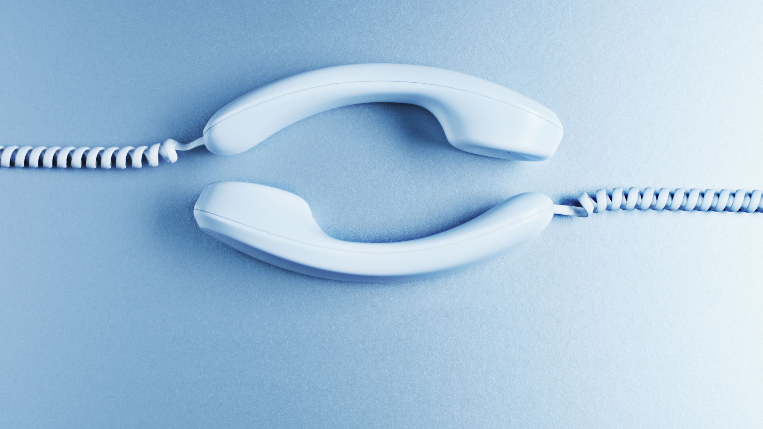
Ready to Obey
Heading the gospel call

Slide 2
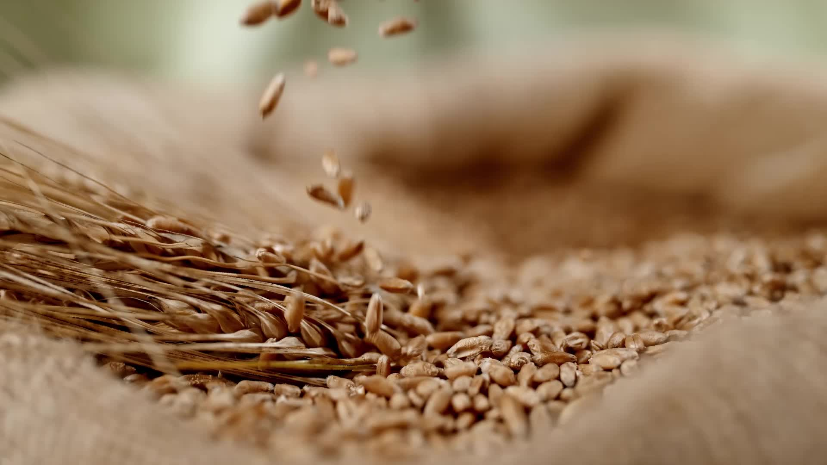
Are you ready to obey?
2 Thessalonians 1:7-8 … the Lord Jesus will be revealed from heaven with His mighty angels in flaming fire, dealing out retribution to those who do not know God and to those who do not obey the gospel of our Lord Jesus.

Slide 3
Are you ready to obey?
Willingness
&
Ability

Slide 4
Ability: Knowledge
Romans 10:13-14 for "WHOEVER WILL CALL ON THE NAME OF THE LORD WILL BE SAVED."
How then will they call on Him in whom they have not believed?
How will they believe in Him whom they have not heard?
And how will they hear without a preacher?

Slide 5
Willingness
Mark 10:17-23 As He was setting out on a journey, a man ran up to Him and knelt before Him, and asked Him, "Good Teacher, what shall I do to inherit eternal life?"
(22) But at these words he was saddened, and he went away grieving, for he was one who owned much property.
(23) And Jesus, looking around, *said to His disciples, "How hard it will be for those who are wealthy to enter the kingdom of God!"

Slide 6
Are you ready to obey?
Luke 9:23-26 And He was saying to them all, "If anyone wishes to come after Me, he must deny himself, and take up his cross daily and follow Me. "For whoever wishes to save his life will lose it, but whoever loses his life for My sake, he is the one who will save it. "For what is a man profited if he gains the whole world, and loses or forfeits himself? …

Slide 7
Are you ready to obey?
Luke 14:27-33 "Whoever does not carry his own cross and come after Me cannot be My disciple.
28 – 30 A Tower
31 – 32 A king in battle
(33) "So then, none of you can be My disciple who does not give up all his own possessions.

Slide 8
Knowledge revisited
Are you ready to obey?
Acts 24:25 Felix
2 Thessalonians 2:8-12 deluding influence
Acts 4:16 “we cannot deny it”

Slide 9
Accountibility

Slide 10
Call to Action : Jews
Acts 2:14-41 … (41) So then, those who had received his word were baptized; and that day there were added about three thousand souls.

Slide 11
Call to Action : Jews
Acts 3:12-4:4
3:19 "Therefore repent and return, so that your sins may be wiped away, in order that times of refreshing may come from the presence of the Lord;
4:4 But many of those who had heard the message believed; and the number of the men came to be about five thousand.

Slide 12
Call to Action : Jews
Acts 8:30-38 (36) As they went along the road they came to some water; and the eunuch said, "Look! Water! What prevents me from being baptized?"

Slide 13
Call to Action : Jews
Acts 16:13-15 … A woman named Lydia, … and the Lord opened her heart to respond to the things spoken by Paul. And when she and her household had been baptized, ...

Slide 14
Call to Action : Gentiles
Acts 10:1-48 (47) "Surely no one can refuse the water for these to be baptized who have received the Holy Spirit just as we did, can he?" And he ordered them to be baptized in the name of Jesus Christ. Then they asked him to stay on for a few days.

Slide 15
Call to Action : Gentiles
Acts 13:6-12 … (12) Then the proconsul believed when he saw what had happened, being amazed at the teaching of the Lord.

Slide 16
Call to Action : Gentiles
Acts 16:25-34 (33) And he took them that very hour of the night and washed their wounds, and immediately he was baptized, he and all his household.

Slide 17
Call to Action : Gentiles
Acts 17:22-34 (30) "Therefore having overlooked the times of ignorance, God is now declaring to men that all people everywhere should repent, … (32) Now when they heard of the resurrection of the dead, some began to sneer, but others said, "We shall hear you again concerning this." So Paul went out of their midst. But some men joined him and believed, ...

Slide 18
Are You Ready?

Slide 19
Are You Ready?
Acts 2:40
"Be saved from this perverse generation!"

