Slide 1
I Believe …
Psalm 90

Slide 2
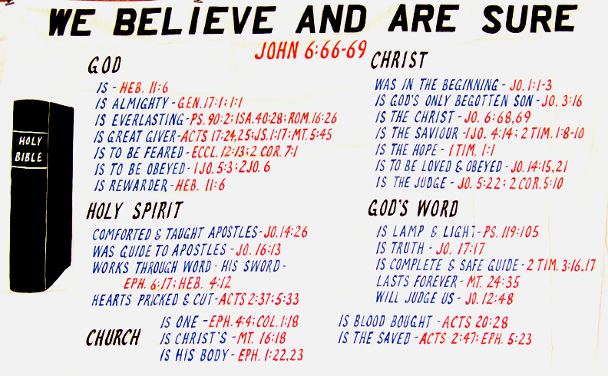

Slide 3
I Believe …
God Is
Genesis 1:1; 17:1
Psalm 90:2
Hebrews 11:6
Isaiah 40:28
Acts 17:24-25
James 1:17
Matthew 5:45
2Corinthians 7:1
Ecclesiastes 12:13

Slide 4
I Believe …
God Is
Jesus Is Christ
John 1:1-3
1John 4:14
John 20:30-31
John 8:24
John 6:66-69
1Corinthians 15:1-4
2Timothy 1:8-10

Slide 5
I Believe …
God Is
Jesus Is Christ
Bible Is God’s Word
Romans 1:1-6
John 17:17
Psalm 119:105
2Timothy 3:16-17
John 14:15,21
Matthew 24:35

Slide 6
I Believe …
God Is
Jesus Is Christ
Bible Is God’s Word
How I Live Matters
Romans 3:23
Romans 6:23
Revelation 3:15-16
James 4:14
2Corinthians 5:10
Romans 14:12
Matthew 7:21

Slide 7
I Believe …
God Is
Jesus Is Christ
Bible Is God’s Word
How I Live Matters
Jesus Is Our Only Hope
1Timothy 1:1
John 5:22
Hebrews 5:9
John 12:48
John 8:31-32
Ephesians 1:22-23
Ephesians 4:4-6

Slide 8
I Believe …
Matthew 7:13-14
Romans 2:4-11
Hebrews 9:27
Matthew 25:31-46
Luke 16:24-26
Hebrews 5:8-9
2Timothy 4:6-8
Unbelievers Will Be Lost

